Slide 1

SMART INDIA HACKATHON 2026
Problem Statement ID – SIH 26213
Problem Statement Title- AI Powered Smart
Badminton Fitness and Performance Analytics System
Theme- Fitness & Sports
PS Category- Hardware
Team Name : NOVA TITANS

Slide 2
AI Powered Smart Badminton Fitness and Performance Analytics System
NOVA TITANS
Problem / Challenge :
Our Proposed Solution :
1. Players evaluated mostly via coach observation without objective, measurable metrics
2. Missing personalized progress analytics to track player improvement across sessions.
3. Lack of data on stroke speed, intensity, consistency, and fatigue during training.
1. AI/ML-Based Player Assessment – Analyse strokes and performance using sensor data.
2. Personalized Training Analytics – Track individual baselines, strengths and improvement.
3. Fitness & Performance Monitoring – Monitor intensity, consistency, workload and fatigue.
4. Smart Player Profiling – Combine session and benchmark data for player insights.
5. Affordable Smart-Racket Platform – Provide a compact solution for training and assessment.
Existing Solutions :
1. Current systems track basic stroke counts, swing speed, and activity using standard wearable sensors and IMUs.
Innovation and Uniqueness :
1. Dual-Signal Stroke Validation – IMU + piezo confirms racket–shuttle impact.
2. Two-Stage Data Processing – Threshold detection followed by ML analysis.
3. Multi-Model Intelligence – Separate ML models for stroke and intensity classification.
4. Benchmark Gap Analysis – Compare player data with trained pro-player reference data.
5. V1 → V2 Evolution – Upgrade the proven prototype with better sensing and connectivity.
Gap Analysis
1. Personalized Player Assessment
2. Integrated Skill + Fitness Analysis
3. Compact & Affordable Racket System

Slide 3
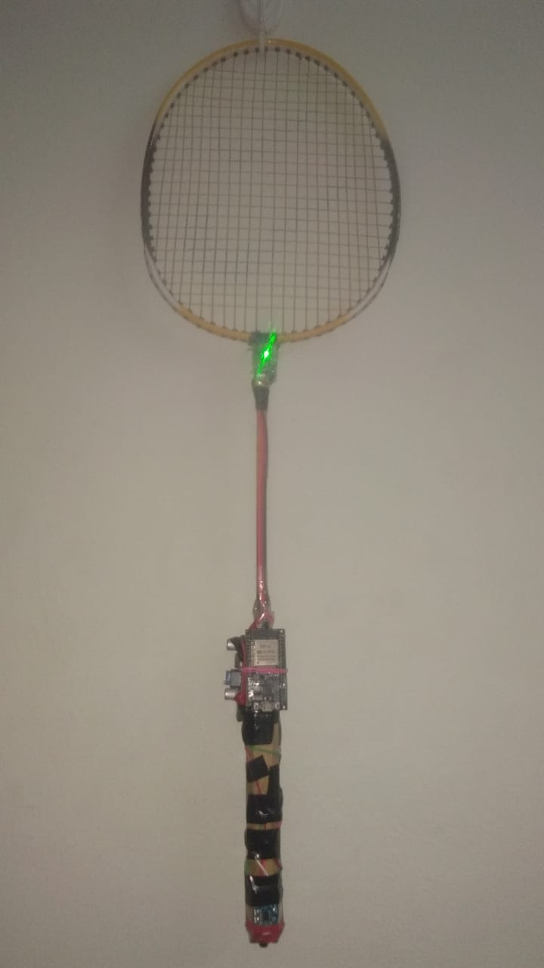
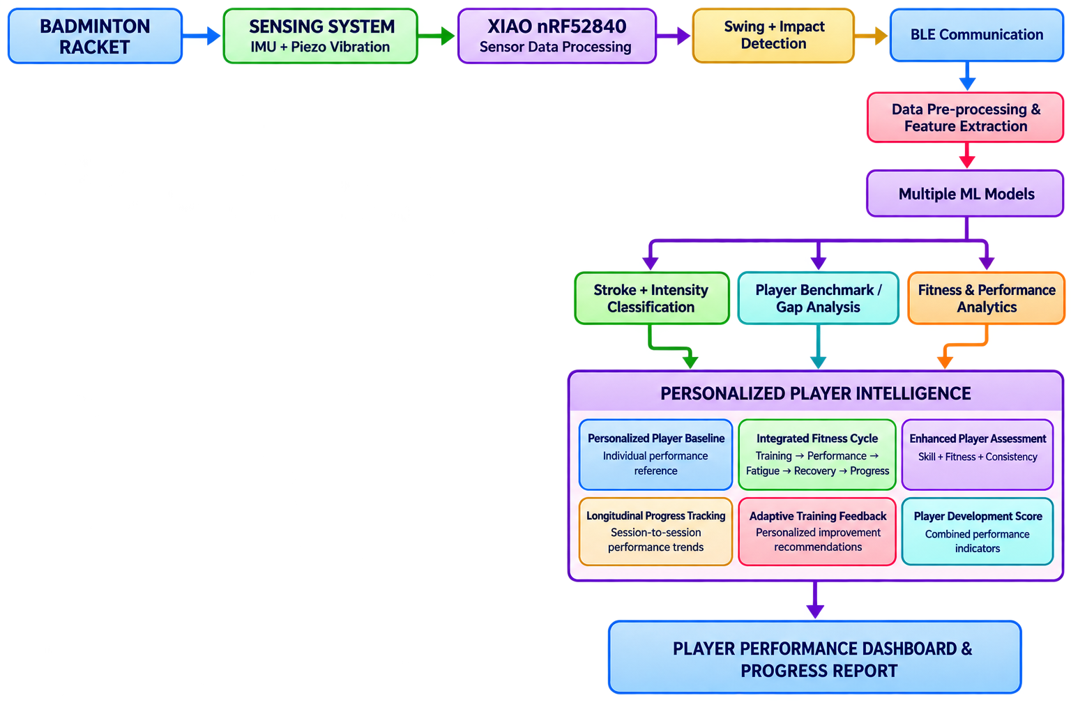
TECHNICAL APPROACH
NOVA TITANS
Technologies to be used:
1. Hardware: XIAO nRF52840, MPU6050 IMU, Piezo vibration sensor
2. Communication: BLE
3. Programming: Embedded C/C++, Python
4. ML: Scikit-learn, multiple classification models
5. Analytics: Pandas, NumPy, Streamlit
6. Data: CSV / Player Benchmark Dataset
Version 1 ( Working Prototype )
1. Smart Racket Prototype – ESP32 + MPU6050 sensor integration completed.
2. Real-Time Swing Detection – Sensor data acquisition and swing detection implemented.
3. Feature Extraction – Speed, impact, duration and related
swing features calculated.
4. ML Classification – Stroke(Smash, Drop, Clear, Drive) and Swing (Weak, Medium, Strong) classification implemented.
5. Performance Dashboard – Streamlit-based session analysis, comparison and player insights developed.

Slide 4
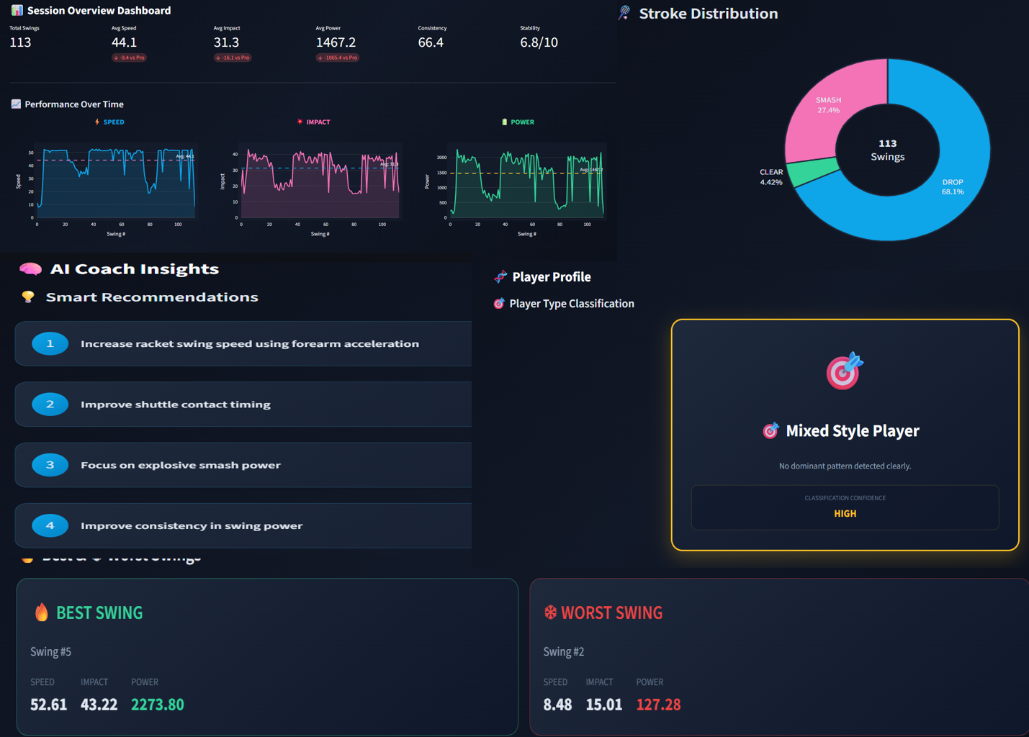
FEASIBILITY AND VIABILITY
NOVA TITANS
Version 1 – Performance Dashboard
Technical Feasibility
1. V1 prototype validates sensing, swing detection and ML processing.
2. V2 uses readily available IMU, Piezo and BLE hardware.
3. Modular design supports future sensor and analytics upgrades.
Challenges
1. Sensor Noise: Racket vibration may cause false impact detection.
2. BLE & Power: Data loss and battery consumption during continuous operation.
3. Personalization: Different playing styles make universal baselines difficult.
Solutions
1. IMU + Piezo fusion, filtering and player-specific calibration.
2. Data buffering + SD/Wi-Fi fallback for communication reliability.
3. Adaptive power modes + multi-session baselines for efficiency and personalization.

Slide 5
IMPACT AND BENEFITS
NOVA TITANS
Target Audience Impact Analysis
Players & Beginners
Get measurable feedback on stroke quality, consistency and progress. Identify individual strengths and areas for improvement.
Coaches & Badminton Academies
Enable data-driven player evaluation beyond visual observation. Monitor player performance and development across training sessions. Identify training needs and support personalized coaching strategies.
Sports & Biomedical
Support early identification of performance decline and injury-risk indicators through changes in movement patterns.
Benefits Analysis
Training & Performance Benefits
Enables session-wise and long-term performance tracking. Helps establish measurable benchmarks for player development.
Biomedical & Sports Science Benefits
Generates structured datasets for sports biomechanics and movement research. Can support future integration with physiological sensors for more comprehensive fitness assessment
Economic Benefits
Affordable and portable compared with high-end sports analytics systems. Can be deployed across multiple players and training centres at relatively low hardware cost.

Slide 6
RESEARCH AND REFERENCES
NOVA TITANS
1. Wearable Sensing & AI
Jin, G., LI, X. Wearable sensing for badminton stroke recognition with one-dimensional convolutional neural network. Sci Rep 15, 41236 (2025). https://doi.org/10.1038/s41598-025-25158-2
2. Badminton Biomechanics & Performance Dataset
Seong, M., Kim, G., Yeo, D. et al. MultiSenseBadminton: Wearable Sensor–Based Biomechanical Dataset for Evaluation of Badminton Performance. Sci Data 11, 343 (2024). https://doi.org/10.1038/s41597-024-03144-z
3. AI-Based Badminton Motion Analysis
Zhu, X., Liu, L., Huang, J. et al. The analysis of motion recognition model for badminton player movements using machine learning. Sci Rep 15, 19030 (2025). https://doi.org/10.1038/s41598-025-02771-9
Jacob, Alvin, Wan Nurshazwani Wan Zakaria, and Mohd Razali Bin Md Tomari. "Implementation of IMU sensor for elbow movement measurement of badminton players." 2016 2nd IEEE International Symposium on Robotics and Manufacturing Automation (ROMA). IEEE, 2016.
Li, Li, and Feng Li. "Recognizing badminton hitting movements Based on Multi-sensor trajectory recognition algorithm." 2023 3rd International Conference on Information Technology and Contemporary Sports (TCS). IEEE, 2023.

